Slide 1
The economic and social impact of gautrain
Headlines from the Report – July 2019

Slide 2
Delivering Change
Urban rail infrastructure creates transformative economic and social benefits.
Governments around the world are using rail systems to increase prosperity and drive progress.
GDP Growth
Job Creation
Stimulating Industry
Uplifting Communities
Sources: Various. All sources for this contextual data are listed in Main Report.

Slide 3
The Need for Change in Gauteng
Rapid Population Growth
Gauteng’s population will increase to 18.7m by 2037
Annual population growth in Gauteng (+1.7%) is well above the SA expected rate
Significant Traffic Congestion
Peak hour trips on key roads take 70% longer than during the off-peak
Deep Poverty and Inequality
Gauteng’s unemployment rate is 29%, which is above the SA average
Employment in the formal sector has declined to around 77%
Intense Global Competition
The City of Johannesburg is ranked 42nd out of 44 cities on the Global Power City Index (2018)
Gauteng needs to invest in infrastructure to better compete on the global stage
If no improvements are made average road speeds could deteriorate to 10km/hr by 2037
Sources: Various. All sources for this contextual data are listed in Main Report.

Slide 4
How Gautrain is Delivering Change Five Pillars of Impact
Delivering Jobs and Social Investment
Changing Perceptions and Attracting Investment
Influencing Transport Choices
Integrating the Region and its Communities
Reinforcing Development Nodes

Slide 5
Impacts Achieved to date 2010 - 2018

Slide 6
Delivering Jobs and Social Investment
Average length of employment at Gautrain
= 5.75 years
Average length of employment in South Africa
= 4 years
Construction Phase Impacts
(Over six years)
35,000 direct jobs delivered* and around 87,300 through supply chain and wage spend
R128m spent on training by the Concessionaire and their contractors
20,300 direct jobs for young people
51% of jobs at the entry level (NFQ 0-1)
13% mid-level (NFQ 2-4)
35% at the higher level (NFQ 4+)
R19.4bn contribution to GDP over 6 years
Operational Impacts
(Over six years)
10,900 direct jobs delivered* and around 61,000 through supply chain and wage spend
R59m spent on training by the Concessionaire to date
5,800 direct jobs for young people
93% of jobs are mid-level roles (NFQ 2-4) 7% are at the higher level (NFQ 4+)
R20.4bn contribution to GDP over first 6 years
*1 job = 1 full year of
employment
Sources: Seriti; Hatch Calculations; Bombela Operating Company; Stats SA; CIDB; KPMG

Slide 7
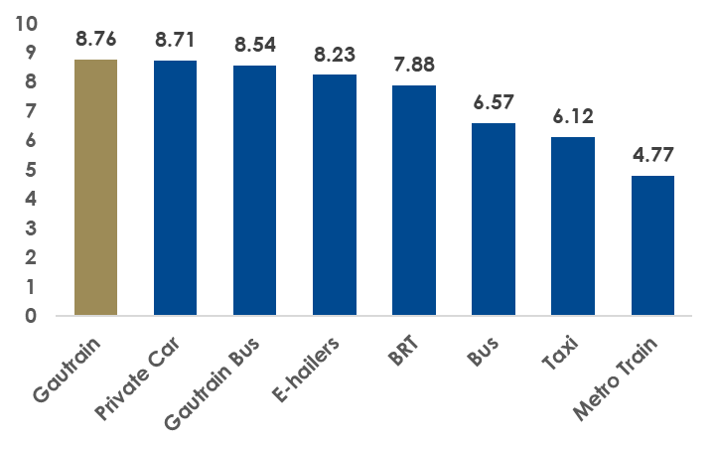
Influencing Transport Choices
Gautrain represents a new era in public transport
Quality of service rating (Max score = 10)
Each person who has chosen to make a trip on the Gautrain instead of in a car has delivered...
R74 of economic benefit per trip
Reduced costs from fatal accidents
CO2 emission savings
Saves 22 minutes on average
87% of Gauteng residents think that Gautrain is a good idea
Sources: GMA Market Segmentation Report; GMA Perceptions Survey; Hatch Calculations

Slide 8
Reinforcing Development Nodes
Since 2010…
+820,000 sqm floorspace
45% increase in median sales values per sqm
+31,000 sqm floorspace
32% increase in median sales values per sqm
Office
Retail
Within 2km of stations
Within 2km of stations
+805,000 sqm floorspace
109% increase in median sales values per sqm
+138,000 sqm floorspace
52% increase in median sales values
Other Commercial
Residential
Within 2km of stations
Within 2km of stations
+1,656,000 sqm more commercial space around stations since 2010
87% occupancy rates in new commercial space which supports around 66,000 jobs
Sources: GeoTerra; Lightstone; Homes and Communities Agency Employment; SAPOA; Hatch Calculations

Slide 9
59% of all office development activity in major South African nodes in 2018 was located around Gautrain stations
Sources: SAPOA (South African Property Owners Association)

Slide 10
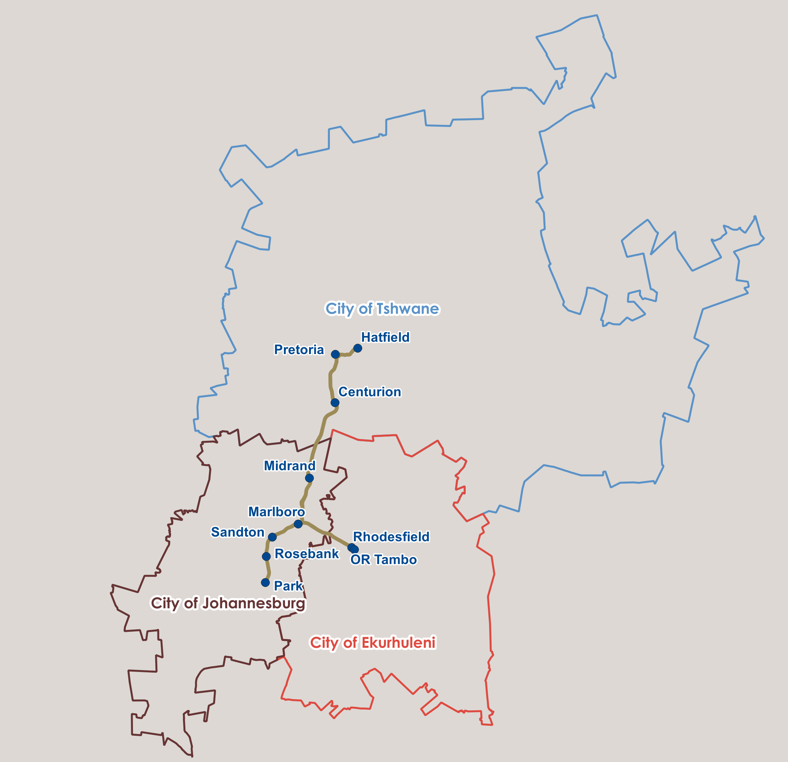
Integrating the Region and its Communities
3.8m
trips from Tshwane to Jhb/ Ekurhuleni in 2018
c.70% of all trips on Gautrain cross a city boundary
4.8m
trips from Jhb to Tshwane/ Ekurhuleni in 2018
1.6m
trips from Ekurhuleni to Tshwane/ Jhb in 2018
Sources: GMA Ticketing Information; Google Maps

Slide 11
Integrating the Region and its Communities
Why do people use Gautrain to cross city boundaries?
Shifting from car to Gautrain typically saves
43 minutes
between Pretoria Station (Tshwane) and Sandton Station (Johannesburg) at typical 7am peak
Shifting from car to Gautrain typically saves
44 minutes
between Rhodesfield Station (Ekurhuleni) and Sandton Station (Johannesburg) at typical 7am peak
Shifting from car to Gautrain typically saves
31 minutes
between Pretoria Station (Tshwane) and Rhodesfield Station (Ekurhuleni) at typical 7am peak
Sources: GMA Ticketing Information; Google Maps

Slide 12
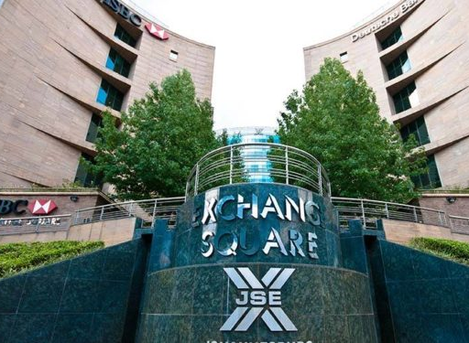
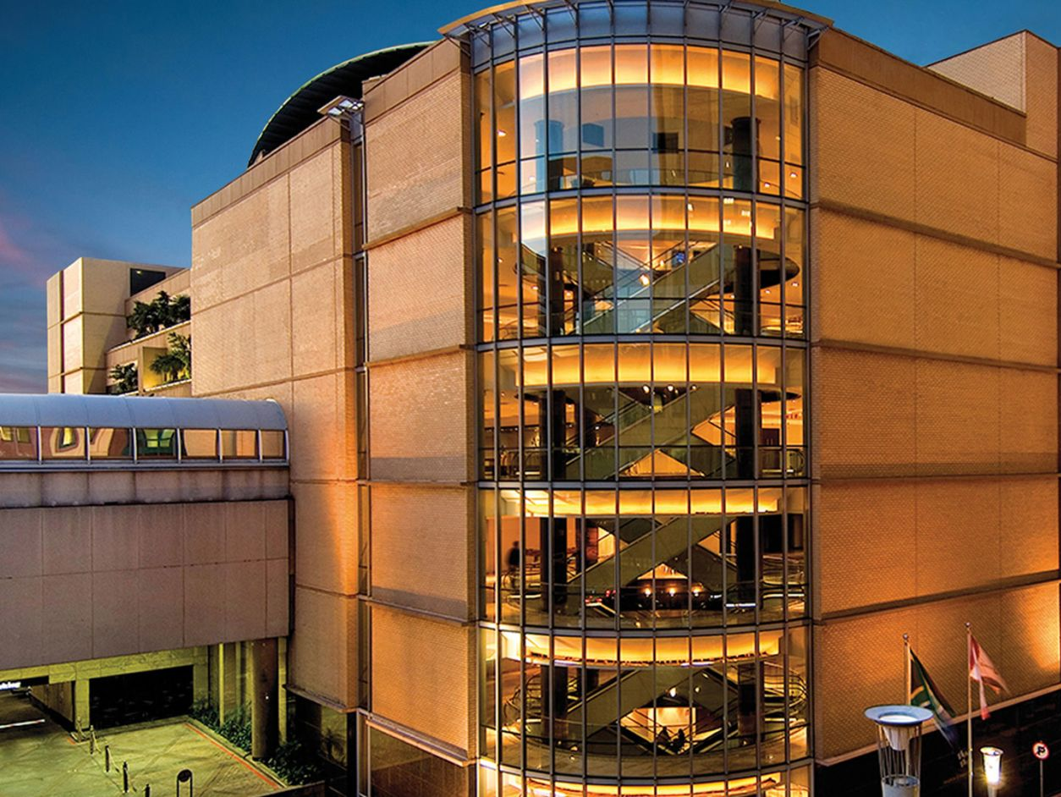
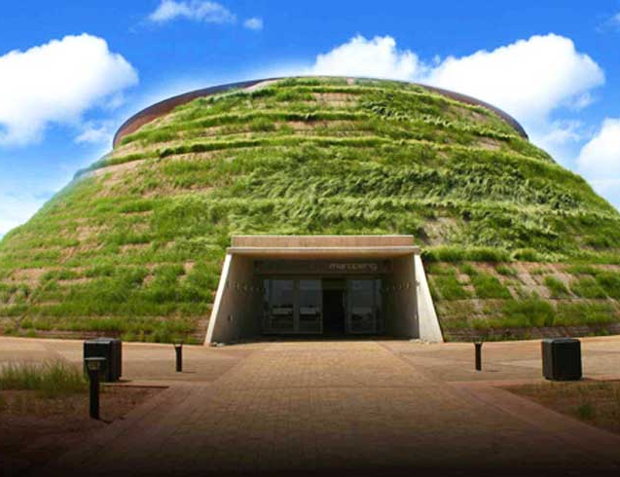
Changing Perceptions and Attracting Investment
↑ Foreign Direct Investment
↑ Conferences
↑ Visitors
Over R44bn of FDI into Gauteng in 2016
Over 80 conference centres in Gauteng
Over 4.3m visitors came to Gauteng in 2016
This is the highest recorded since 2003
The number is growing annually
The number is growing annually
Johannesburg was the 2nd highest recipient of FDI in Africa between 2013-16
3 of the largest 5 conference centres are within 3km of Gautrain stations
45% of South Africa’s tourism income generated in Gauteng
Sources: Gauteng Province Socio-Economic Review and Outlook, 2018; Gauteng Growth and Investment Agency Handbook; Gauteng Tourism Authority Annual Report 2016/17

Slide 13
Summary of Key Impacts Achieved to Date
Delivering Jobs and Social Investment
Guatrain has already created 35,000 direct construction jobs and 10,900 direct operational jobs
Changing Perceptions and Attracting Investment
FDI investment into Gauteng increased to over R44bn
in 2016
Now over 80 conference centres in Gauteng
Influencing
Transport Choices
87% of residents believe Gautrain is a good thing
Each trip on Gautrain instead of a car delivers R74 in economic benefit
Integrating the Region and its Communities
70% of all trips on Gautrain cross a city boundary
Reinforcing Development Nodes
New commercial space around stations = 66,000 jobs
59% of office development activity in SA nodes in 2018 was located around stations

Slide 14
Key Performance Metrics Contribution to Annual GDP Growth
Average GDP growth in Gauteng in last 10 years = 2.4% per annum (Stats SA)
Context
GDP at mid point of this period = R 1,174 Bn (Stats SA)
In a typical construction year
Gautrain added R3.3 Bn per annum to GDP
Gautrain added 0.28% per annum to GDP (R3.3Bn / R1,174 Bn)
Gautrain added R6.6 Bn per annum to GDP
In a typical year post-construction
R 3.4 Bn from direct + indirect + induced jobs
R 2.7 Bn from jobs within new commercial property next to stations
R 0.5 Bn from construction jobs of new commercial property
Gautrain added 0.55% per annum to GDP

Slide 15
Key Performance Metrics Return on Capital Investment (ROI)
Outturn Prices
R99.7 Bn of GDP added via construction and operations over ten years
Public sector cost: R26.5 Bn to construct and R12.5 Bn to operations over ten years
Gautrain = R1 : R2.6
UK Crossrail = £1 : £3.0
Aus Inland Rail = $1 : $2.0

Slide 16
UPLIFTING THE TOWNSHIPS

Slide 17
Creating Construction and Operational Jobs for Township Residents
Construction Jobs
E.g. engineers, labourers, technical specialists, managerial roles etc.
Operational Jobs
E.g. drivers, managers, cleaners, guards, engineers, ticket
operators etc
c.7,600 direct
construction jobs taken by people
from lower income households
c.7,000 direct
operational jobs taken by people
from lower income households
Source: Bombela Operating Company
Source: KPMG and Hatch Estimations
Note: Data collection method for operational jobs differs from KPMG approach for construction jobs

Slide 18
Creating Jobs in Development Nodes near Townships
Alexandra and Sandton/Marlboro
Alexandra residents can easily access Marlboro and Sandton (via the Grayston Pedestrian Bridge)
Commercial floorspace around these stations has grown by 506,000 sqm since 2012
A proportion of new jobs are taken by people from Alexandra – E.g.
Around 50% of staff at Radison Blu Gautrain live in Alexandra
Around 40% of staff at Saint restaurant and bar live in Alexandra
Sources: GeoTerra; Hatch Research

Slide 19
Shaping Gauteng’s future

Slide 20
Gauteng’s Sustainable Future
GMA plan to invest in improving the existing network via:
GMA also plan to extend the system by investing in the construction of new track and stations:
New stations at Modderfontein, Samrand
and Waterfall
Commercialisation of Centurion and Marlboro
New rolling stock, depot and operator
facilities
Upgrades to system capacity
Additional new buses
Y-link to connect northern part of system directly to O.R. Tambo International Airport
Parking enhancements at Rosebank, Pretoria and Hatfield
149km of new dual track
19 new stations

Slide 21
Inclusive Employment for All – Future Jobs
Construction Phase Impacts
Spend could create up to 175,000 additional direct jobs and around 438,000 through supply chain and wage spend
Over R60bn of salary would be delivered
c.R100bn contribution to GDP over a circa 20 year period
Operational Phase Impacts
Operation of the new complete network could deliver at least an additional 68,000 direct jobs over 20 years of operation and an additional 380,000 through supply chain and wage spend
Around R74bn of salary would be delivered over 20 years
At least c.R126bn contribution to GDP over 20 years
Sources: Seriti; Hatch Calculations; KPMG

Slide 22
An Even More Integrated City Region
New infrastructure will link people to better employment, training and education opportunities
Over 2.2m people will be brought within 2km of the line - 18% of the population of Johannesburg, Tshwane and Ekurhuleni
Around 2m township residents will also be linked to the network and nodes in the centre of the province
Gauteng residents will also have a safer, faster and more reliable transport option – currently over 52% of people use informal modes of transport or walk to get to work
Sources: Census; Gauteng City Region Observatory

Slide 23
Key Performance Metrics – Future Gautrain
Assume GDP growth continues to be circa 2.4% per annum
Context
In a typical construction year
Gautrain will add 0.33% per annum to GDP
Bigger impact than existing network due to larger construction spend per annum
In a typical year post-construction
Gautrain will add at least 0.83% per annum to GDP
Bigger impact than currently due to growth of stations and associated jobs

Slide 24
In Summary: the Report Demonstrates
1
Gauteng Faces Profound Economic and Social Challenges
- Status Quo is Not an Option
- A Proven Need to Invest
2
Gautrain Has Already Delivered Significant Economic and Social Benefits
- Jobs and Addressing Poverty
- Perceptions of Public Transport
- Connecting Communities
- Image of the Province
4
In the Future Gautrain Will Have a Transformative Impact
- A Full and Integrated Network of Stations
- Accelerating the Move to Public Transport
- Linking Many More Communities into Growth
- New Instruments to Maximise Economic Impacts
3
Gautrain Represents Value for Money
For every rand invested, R2.6 of economic benefit has been delivered to the Gauteng Region

Slide 25
The economic and social impact of gautrain

